Slide 1
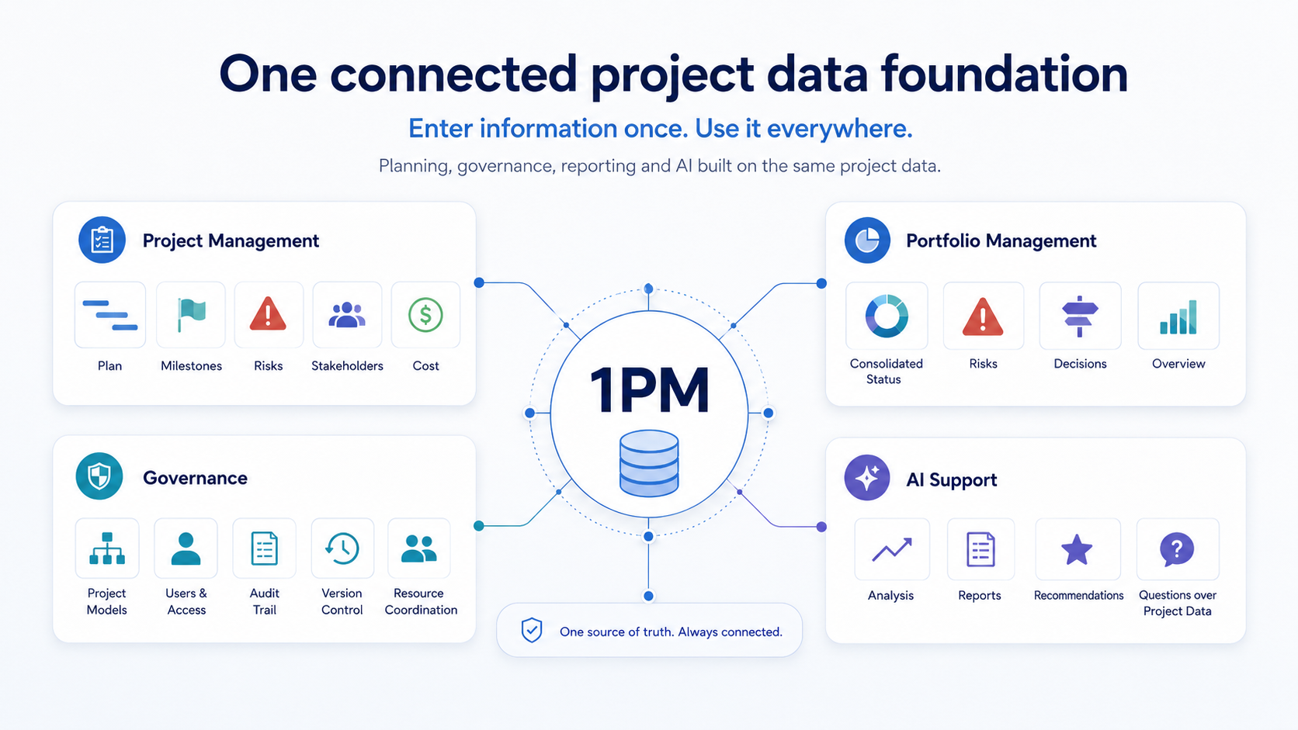
1 · Introduction 2 · Why 1PM 3 · Product tour 4 · Get started
CONNECTED PPM
1PM — One Project
Management solution.
1PM connects project governance, planning, team execution, reporting and portfolio management in one solution — so you spend less time maintaining information and more time managing projects.
This presentation shows how it creates value in practice — and how to get started.
IN THIS PRESENTATION
One connected data foundation powering Project Management, Team Workspace, Portfolio Management, Governance and AI Support.
2
Why 1PM
9 slides
3
Product tour
6 slides
4
Get started
9 slides
9 principles behind how 1PM changes daily project and portfolio work.
6 real screens — portfolio, project, governance and AI in practice.
A guided path from an empty account to participant-ready projects and portfolio oversight.
1PM Introduction Presentation
1PM
01

Slide 2
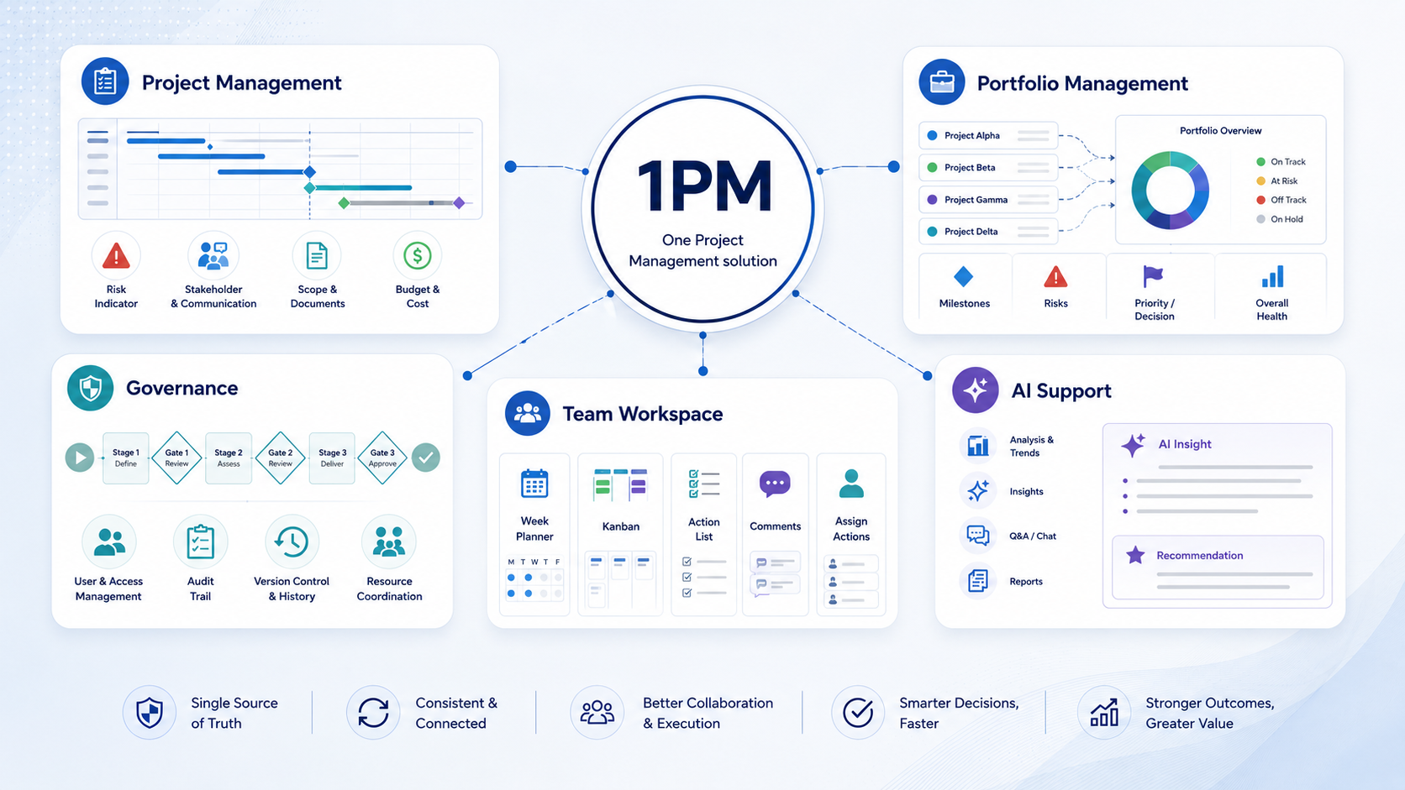
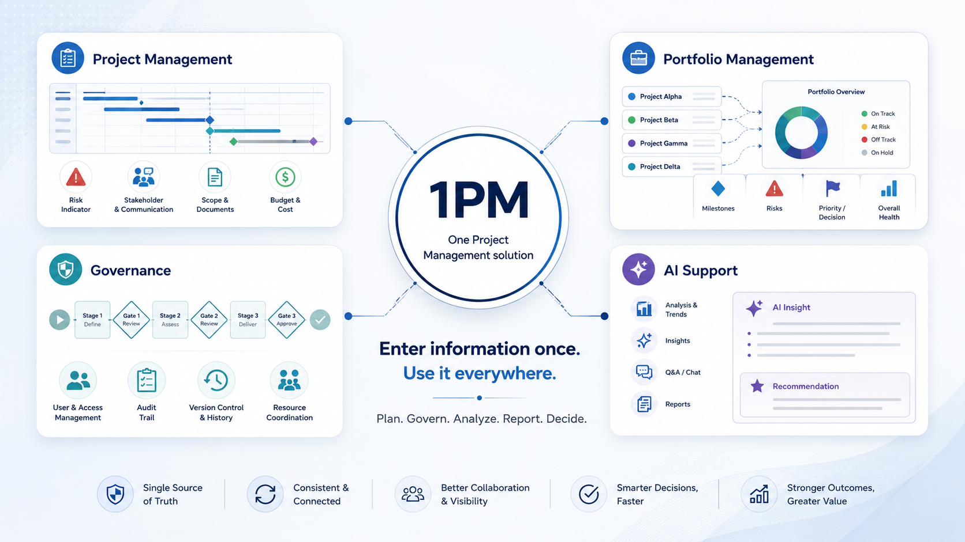
1 · Introduction 2 · Why 1PM 3 · Product tour 4 · Get started
Connect and report
01
ONE CONNECTED SOURCE OF TRUTH
Bring the management information that matters together.
Objectives, scope, plans, risks, resources, actions and reports can be managed directly in 1PM or supported by specialist tools where appropriate. 1PM brings the information needed for management, governance, reporting and portfolio decisions together in one connected foundation.
Define objectives, scope and business-case information in 1PM
Use 1PM’s built-in tools or specialist tools where they fit
Bring relevant information together for reporting, governance and portfolio insight
Why 1PM
1PM
02

Slide 3
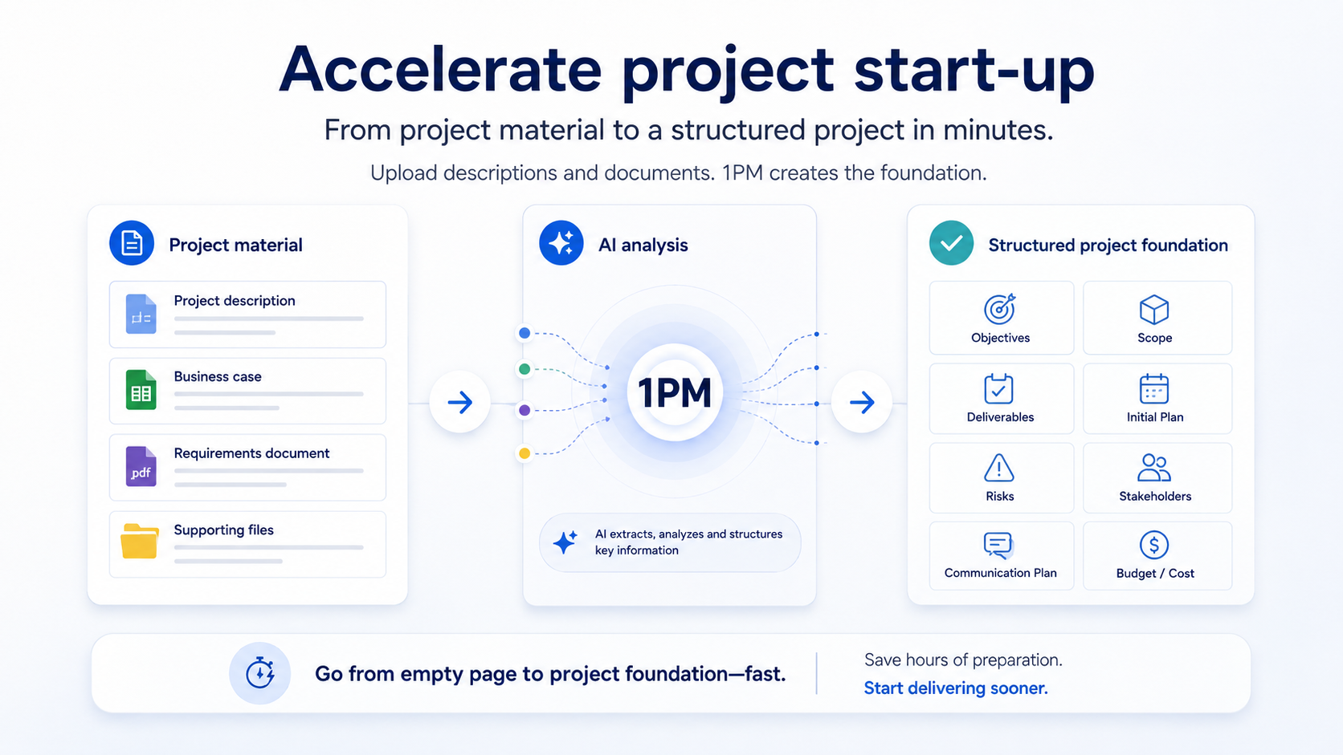
1 · Introduction 2 · Why 1PM 3 · Product tour 4 · Get started
Start and plan
02
START PROJECTS FASTER
Turn existing material into a usable project foundation.
Upload project descriptions, business cases, requirements and supporting documents. 1PM analyzes the material and creates a structured foundation with objectives, scope, deliverables, stakeholders, risks and an initial plan.
Upload descriptions, business case and requirements
AI extracts and structures the key information
Continue refining directly in the connected 1PM environment
Why 1PM
1PM
03

Slide 4
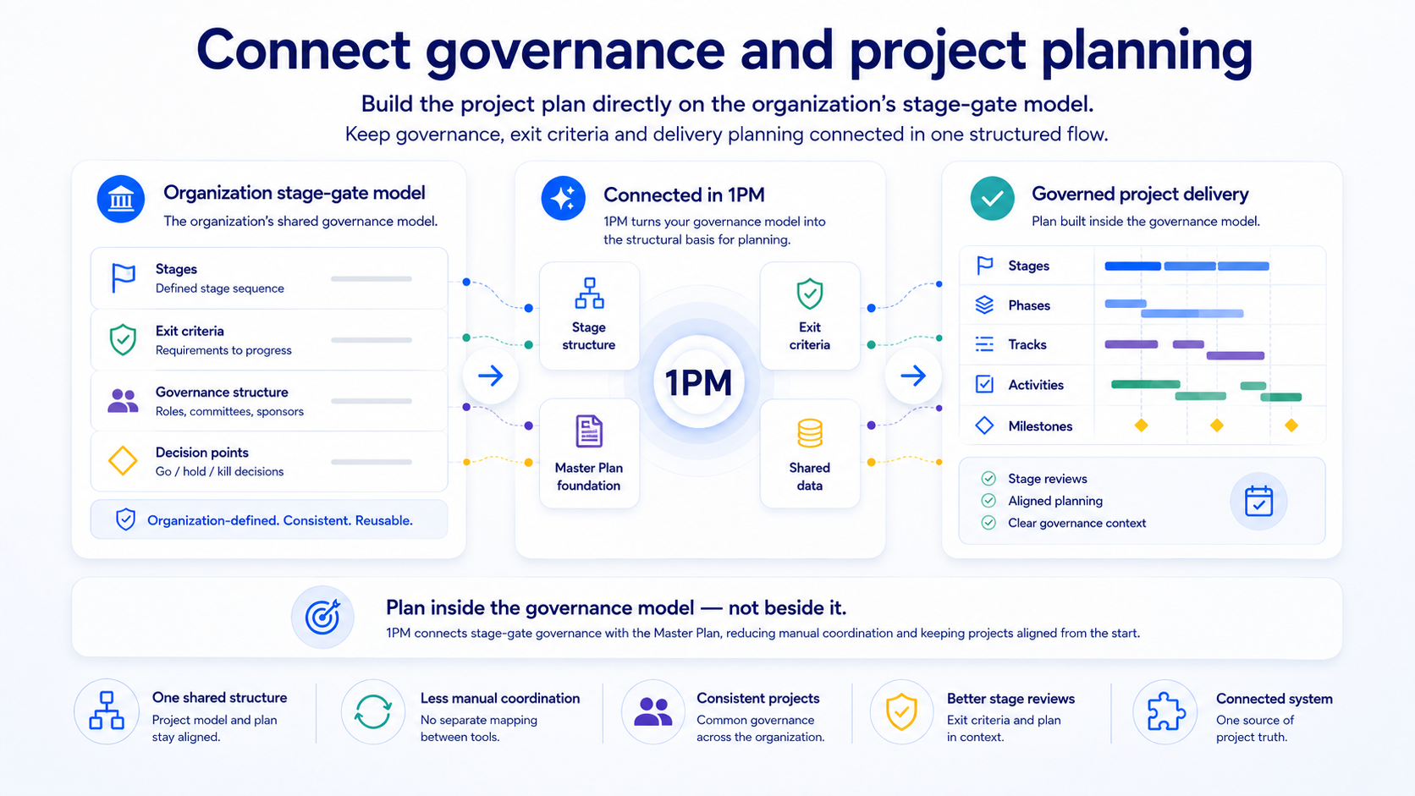
1 · Introduction 2 · Why 1PM 3 · Product tour 4 · Get started
Start and plan
03
GOVERNANCE BUILT INTO THE PLAN
Apply the project model where planning happens.
The organization's stage-gate models becomes the structural foundation for the project's Master Plan. Governance, planning and execution remain connected from the moment the project is created.
Create projects from the approved organizational model
Build the Master Plan within the inherited stages
Use the same structure for stage reviews and reporting
Why 1PM
1PM
04

Slide 5
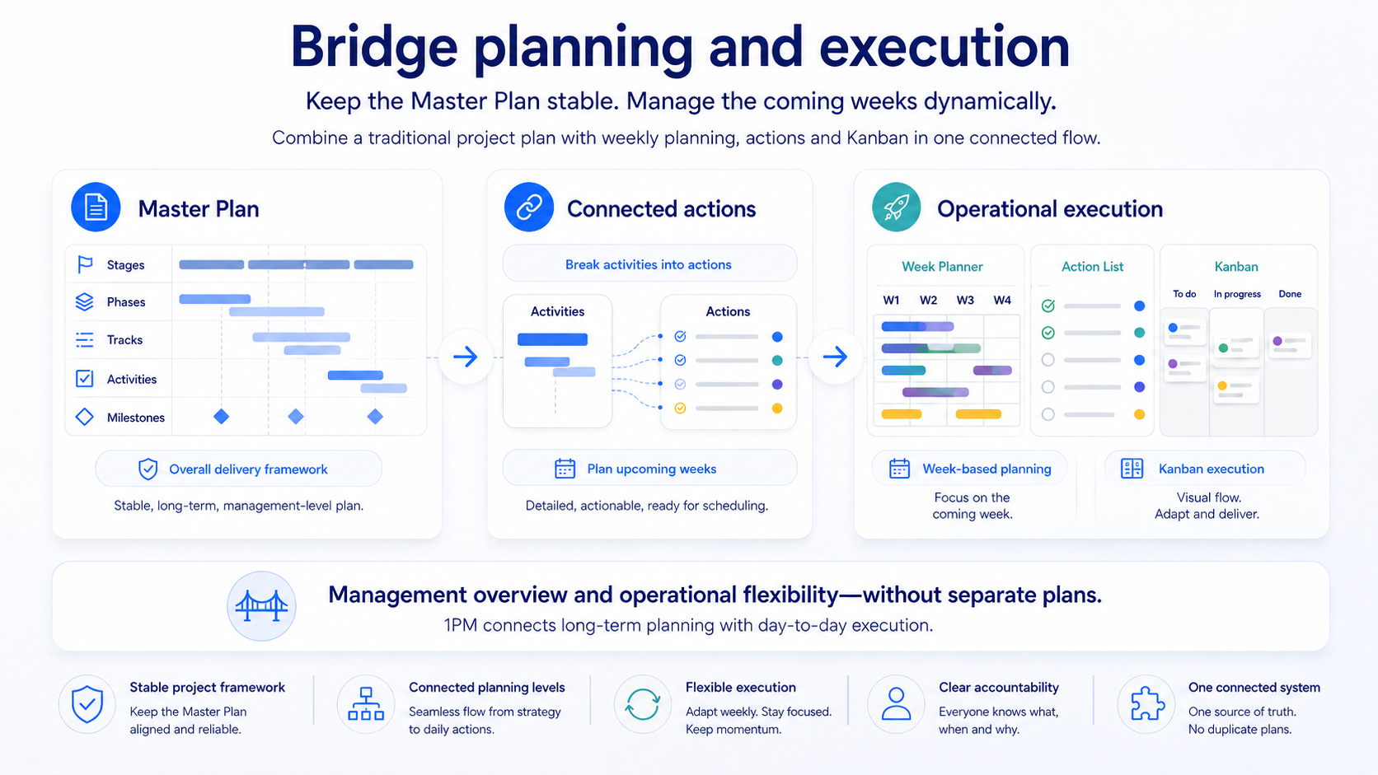
1 · Introduction 2 · Why 1PM 3 · Product tour 4 · Get started
Start and plan
04
CONNECT THE PLAN WITH TEAM EXECUTION
When teams work directly in 1PM, planning and execution stay fully connected.
1PM connects the structure of traditional project planning with the flexibility of modern agile ways of working. When projects use 1PM’s built-in Project Management and Team Workspace, the Master Plan, actions and team execution stay fully connected.
Use stages, phases, tracks and milestones for the delivery path
Break selected activities into connected actions
Execute dynamically in Team Workspace, still linked to the plan
Why 1PM
1PM
05

Slide 6
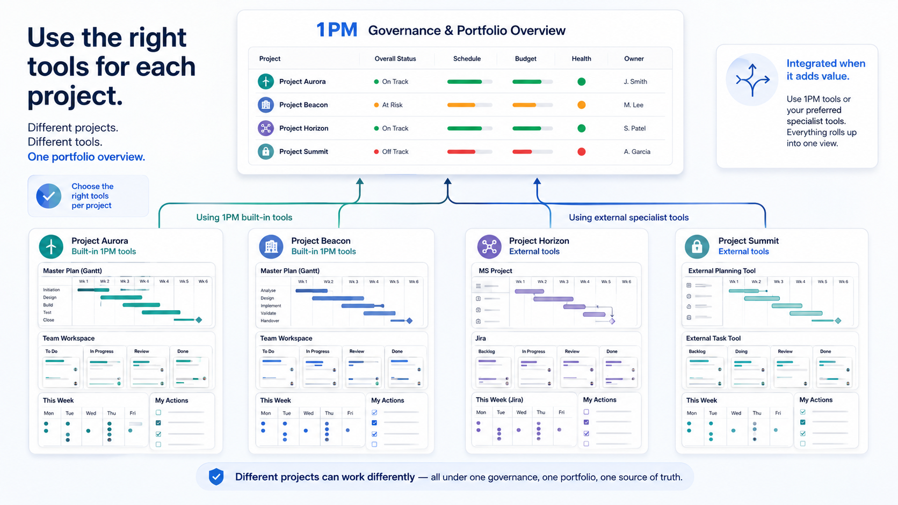
1 · Introduction 2 · Why 1PM 3 · Product tour 4 · Get started
Start and plan
05
USE THE RIGHT TOOLS — AND MOVE AT YOUR OWN PACE
Keep what works today. Move more into 1PM when it adds value.
Projects do not have to change tools at the same time. Some can continue using Microsoft Project, Jira or other specialist tools, while others use 1PM’s built-in Project Management and Team Workspace. 1PM brings the management information that matters together for governance, reporting and portfolio oversight — and projects can move further into 1PM gradually.
Keep existing tools where they add value
Use 1PM’s integrated tools for additional value
Move project by project — without a big-bang migration
Why 1PM
1PM
06

Slide 7
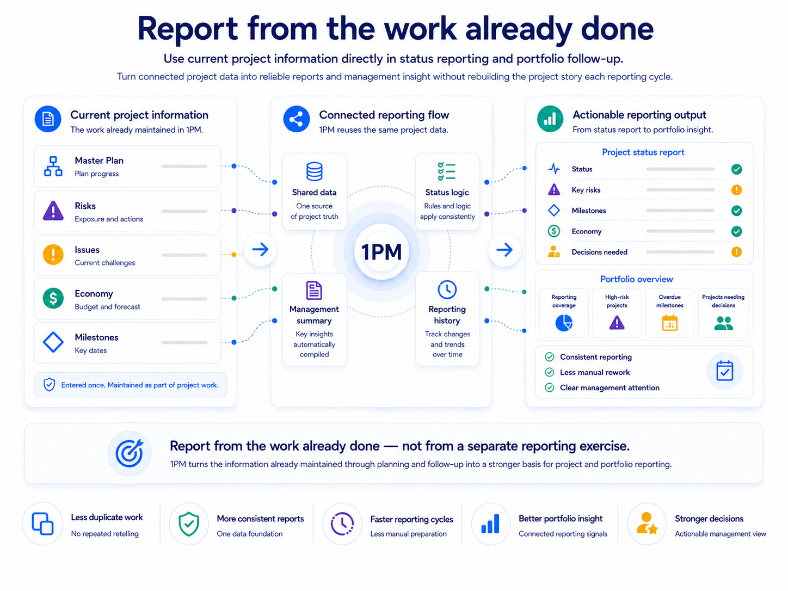
1 · Introduction 2 · Why 1PM 3 · Product tour 4 · Get started
Connect and report
06
LESS REPORTING. BETTER REPORTING.
Create reports from work already managed in 1PM.
Use the project information maintained during normal project management as the foundation for status reporting and portfolio insight — instead of rebuilding the story from scratch.
Keep core project information current where the work happens
Review plan, risk, issue and financial signals before reporting
Submit into the portfolio reporting period for shared oversight
Why 1PM
1PM
07

Slide 8
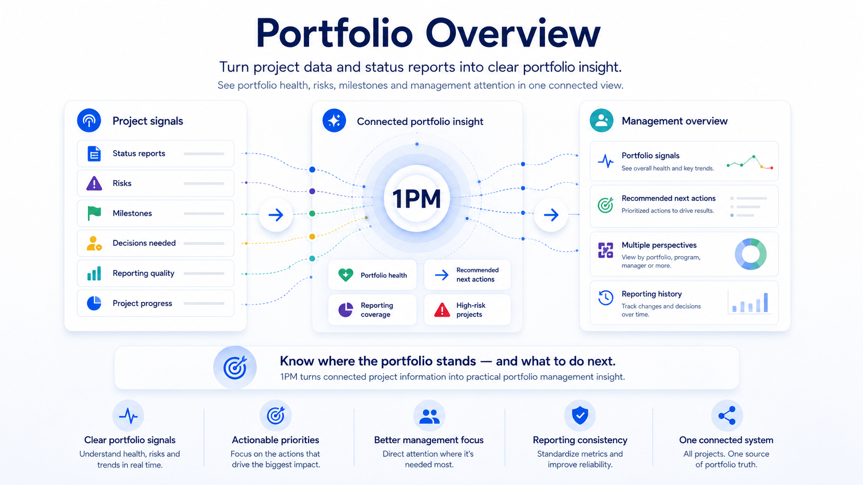
1 · Introduction 2 · Why 1PM 3 · Product tour 4 · Get started
Connect and report
07
SEE THE WHOLE PORTFOLIO CLEARLY
Know what needs attention.
1PM brings project status, progress, milestones, risks, reporting coverage and management attention together in one connected portfolio overview — so managers can see what needs action.
Collect status, milestones, risks and reporting quality
Turn connected project data into portfolio-level insight
Act with clarity instead of separate spreadsheets and slides
Why 1PM
1PM
08

Slide 9
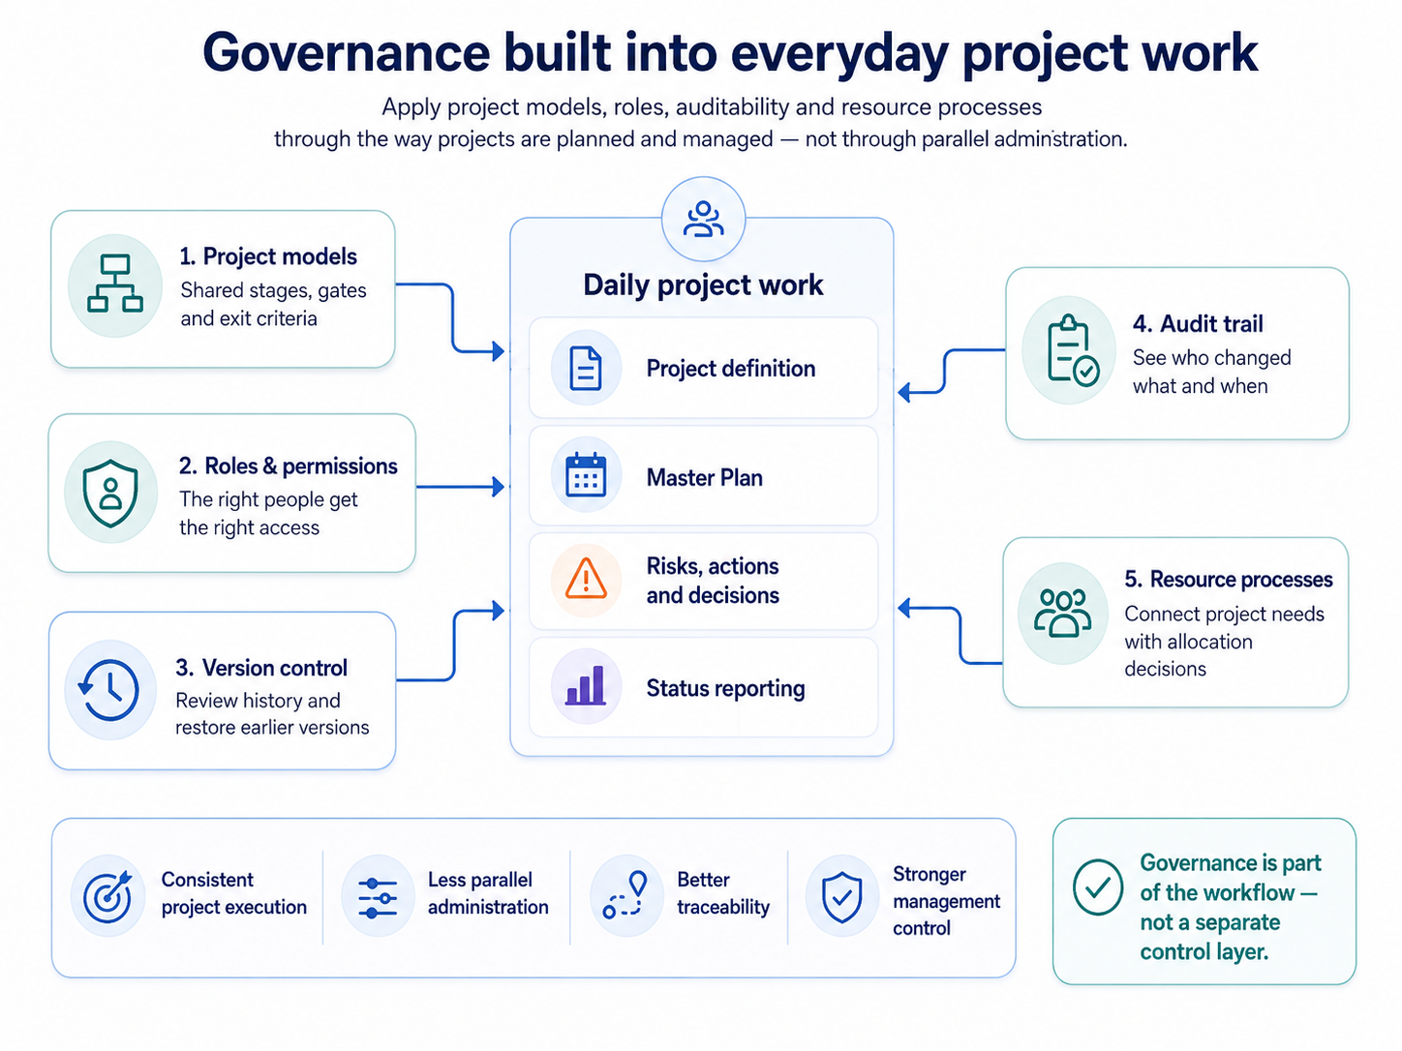
1 · Introduction 2 · Why 1PM 3 · Product tour 4 · Get started
Govern and improve
08
GOVERN WITHOUT ADDING BUREAUCRACY
Keep control without parallel administration.
Apply organizational standards through the way projects are created, planned, shared, reviewed and resourced — without maintaining a separate governance layer.
Use shared project models for consistency across projects
Control access through roles and permissions
Preserve traceability with history and version restoration
Why 1PM
1PM
09

Slide 10
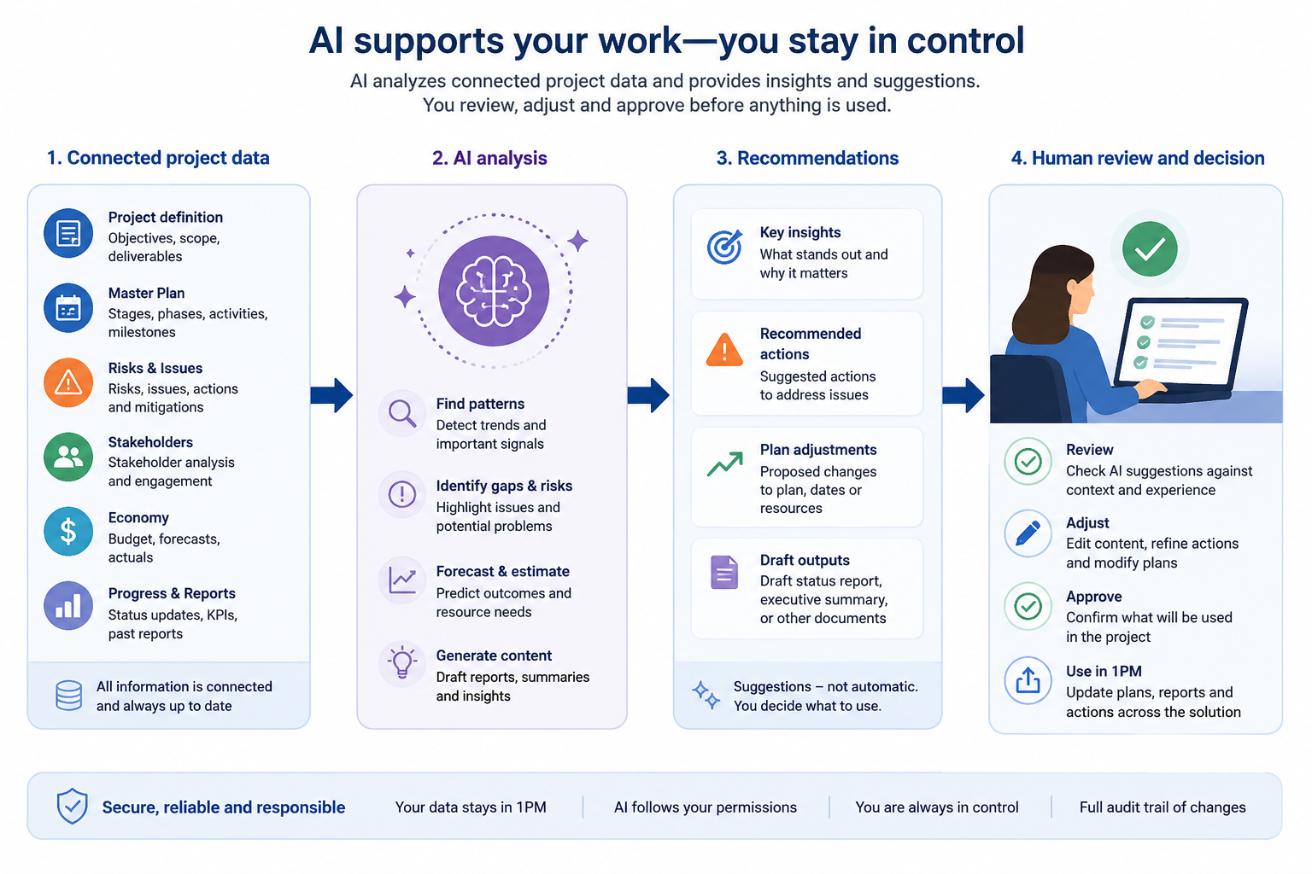
1 · Introduction 2 · Why 1PM 3 · Product tour 4 · Get started
Govern and improve
09
AI THAT UNDERSTANDS YOUR PROJECTS
Use connected project data as AI context.
Apply AI to connected project information while keeping project managers and decision-makers responsible for reviewing, adjusting and approving the result.
Use project documents and structured data as AI context
Choose a focused analysis rather than a generic prompt
Keep human review and approval at every consequential step
Why 1PM
1PM
10

Slide 11
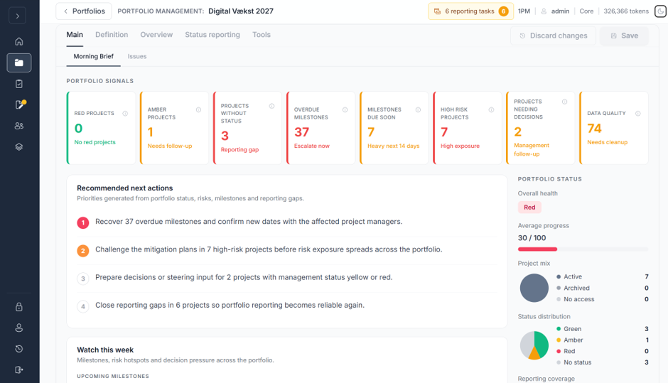
1 · Introduction 2 · Why 1PM 3 · Product tour 4 · Get started
Example 1 of 6
Portfolio
Portfolio Morning Brief
See portfolio health, reporting coverage, risks, overdue milestones and matters requiring management attention in one decision-ready view.
EXPLORE FEATURES
Portfolio Management features →
QUICK GUIDE
Use Portfolio Overview →
Examples — Product tour
1PM
11

Slide 12
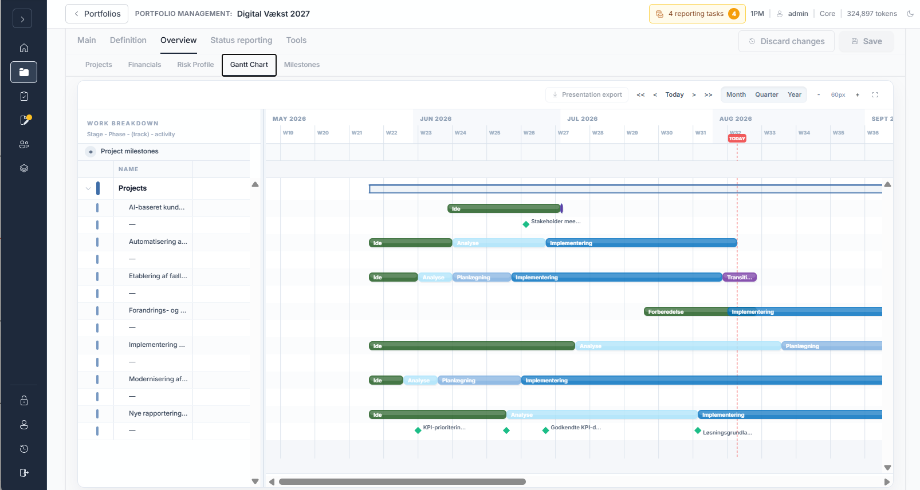
1 · Introduction 2 · Why 1PM 3 · Product tour 4 · Get started
Example 2 of 6
Portfolio
Portfolio Gantt Overview
See every project's stages, phases and milestones aligned on one shared timeline, with today's date marked straight across the whole portfolio.
EXPLORE FEATURES
Portfolio Management features →
QUICK GUIDE
Use Portfolio Overview →
Examples — Product tour
1PM
12

Slide 13
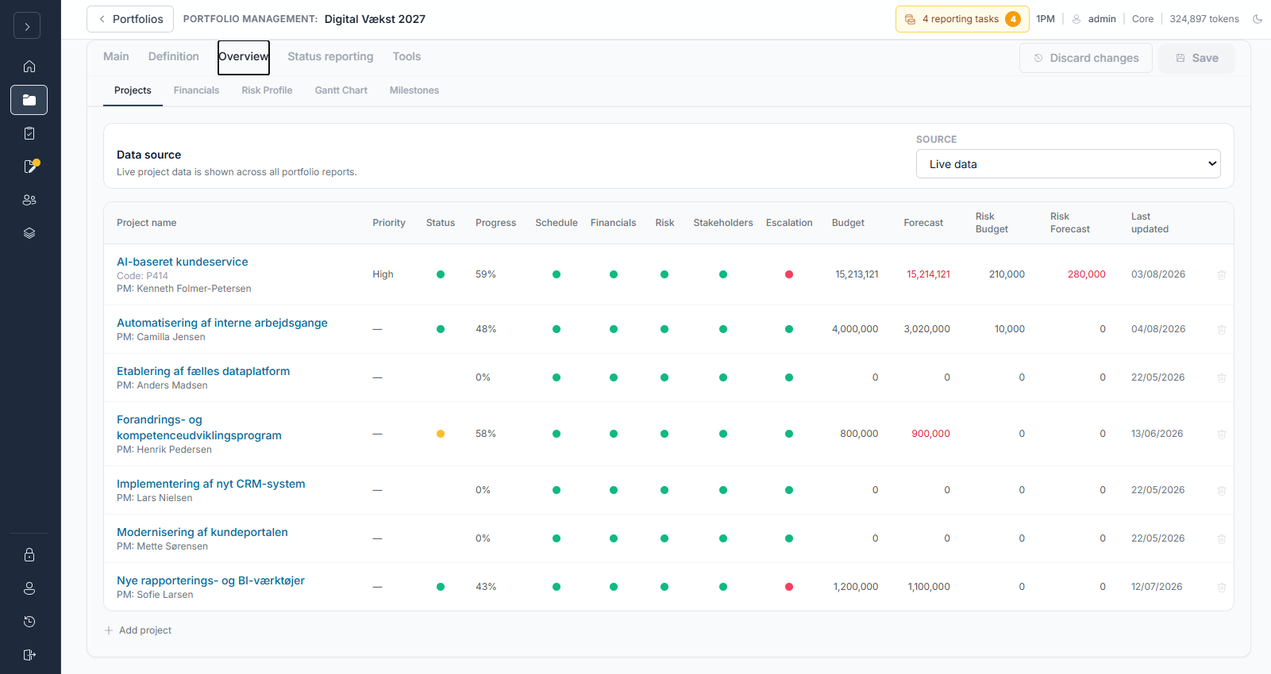
1 · Introduction 2 · Why 1PM 3 · Product tour 4 · Get started
Example 3 of 6
Portfolio
Portfolio Status Overview
Compare status, progress, risk, financials and escalation across every project in the portfolio, from one live, sortable table.
EXPLORE FEATURES
Portfolio Management features →
QUICK GUIDE
Use Portfolio Overview →
Examples — Product tour
1PM
13

Slide 14
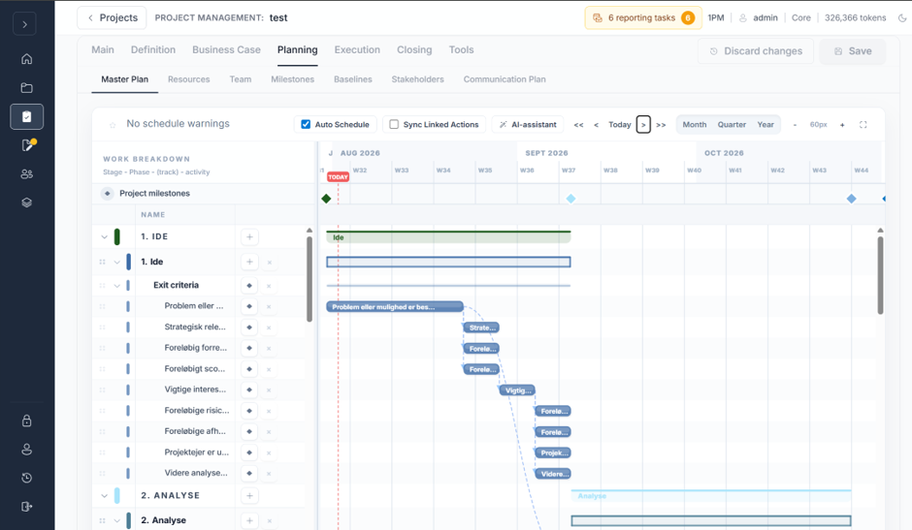
1 · Introduction 2 · Why 1PM 3 · Product tour 4 · Get started
Example 4 of 6
Project
Master Plan
Plan stages, phases, tracks, activities and milestones inside the project model and keep the overall delivery structure connected.
EXPLORE FEATURES
Project Management features →
QUICK GUIDE
Build the Master Plan →
Examples — Product tour
1PM
14

Slide 15
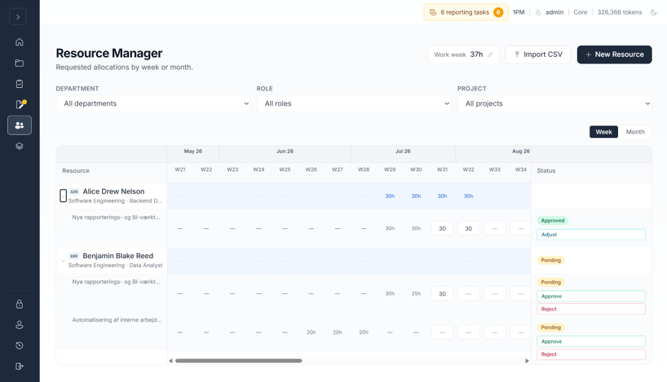
1 · Introduction 2 · Why 1PM 3 · Product tour 4 · Get started
Example 5 of 6
Governance
Resource Manager
Review resource demand across projects and approve, adjust or reject allocation requests through a transparent management process.
EXPLORE FEATURES
Governance features →
QUICK GUIDE
Process resource requests →
Examples — Product tour
1PM
15

Slide 16
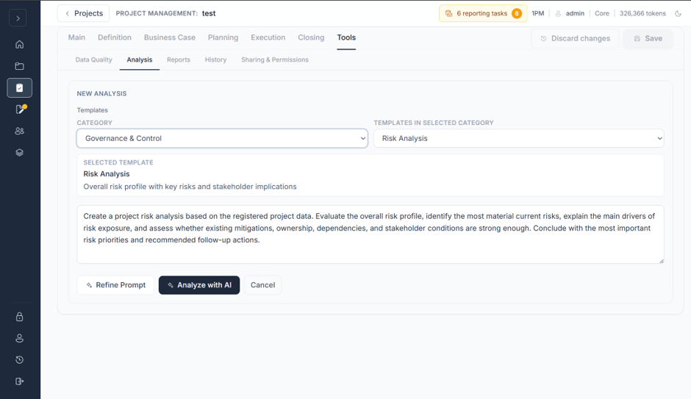
1 · Introduction 2 · Why 1PM 3 · Product tour 4 · Get started
Example 6 of 6
AI
AI Analysis
Use connected project information to generate focused analysis, identify attention points and support better project decisions.
EXPLORE FEATURES
AI Support features →
QUICK GUIDE
Create a project with AI →
Examples — Product tour
1PM
16

Slide 17
1 · Introduction 2 · Why 1PM 3 · Product tour 4 · Get started
Get started
From empty account to live project — fast.
THE ROADMAP AHEAD
01
Create the onboarding team
1PM runs entirely in the browser. There is nothing to install and no IT project to plan — the guided path on the following pages takes a small team from an empty account to a live, reportable project and portfolio in a matter of days.
02
Create the organization's project models
03
Define and import resources
No installation, servers or IT project required
Create Project Managers and Portfolio Managers
04
Seven guided steps, each pointing to the exact screen to use
05
Create and assign the first project
A working project, participants and portfolio live within days
06
Create and assign the first portfolio
07
Add project participants
Get started — Overview
1PM
17

Slide 18
1 · Introduction 2 · Why 1PM 3 · Product tour 4 · Get started
Set the foundation
01
Organization Owner
THE STEPS
Create the onboarding team
Confirm the onboarding responsibilities
01
Create or confirm the PMO and Resource Manager users who will prepare 1PM for the wider organization.
Create or confirm the PMO user
02
Create or confirm the Resource Manager
03
THE OUTCOME
The small onboarding team can configure project governance and resource data before operational users enter the solution.
Activate access
04
Verify the starting point
05
Get started — Quick guides
1PM
18

Slide 19
1 · Introduction 2 · Why 1PM 3 · Product tour 4 · Get started
Set the foundation
02
PMO
THE STEPS
Create the organization's project models
Define the model purpose
01
Stage-gate models provide a structured framework for moving projects through defined stages, with clear review points and criteria before progressing. Define the stages, sequence and exit criteria that projects will use as their shared governance framework.
Create the stages
02
Add exit criteria
03
THE OUTCOME
Reviewed project models are ready before Project Managers begin creating and managing projects.
Review the complete flow
04
Activate the model
05
Get started — Quick guides
1PM
19

Slide 20
1 · Introduction 2 · Why 1PM 3 · Product tour 4 · Get started
Prepare people & resources
03
Resource Manager
THE STEPS
Define and import resources
Prepare the resource data
01
Create or import the resource foundation that Project Managers will use for planning and allocation requests.
Create or import resources
02
Maintain role and department
03
THE OUTCOME
The organization's active resources are available with the information required for project planning and resource management.
Set work week and availability
04
Review the active resource pool
05
Get started — Quick guides
1PM
20

Slide 21
1 · Introduction 2 · Why 1PM 3 · Product tour 4 · Get started
Prepare people & resources
04
Organization Owner
THE STEPS
Create Project Managers and Portfolio Managers
Identify the first operational users
01
Add the operational users after the governance model and resource foundation are ready.
Create the user accounts
02
Assign the appropriate roles
03
THE OUTCOME
Project Managers and Portfolio Managers can sign in to a solution that is prepared for real project and portfolio work.
Activate access
04
Explain the next onboarding step
05
Get started — Quick guides
1PM
21

Slide 22
1 · Introduction 2 · Why 1PM 3 · Product tour 4 · Get started
Go live
05
Organization Owner / PMO
THE STEPS
Create and assign the first project
Select the first project
01
Create a real project, apply the organization's project model and give the first Project Manager a clear starting point.
Create the project
02
Apply the project model
03
THE OUTCOME
The first Project Manager can open a correctly configured project and begin establishing its project foundation.
Assign the Project Manager
04
Verify the handover
05
Get started — Quick guides
1PM
22

Slide 23
1 · Introduction 2 · Why 1PM 3 · Product tour 4 · Get started
Go live
06
Organization Owner / PMO
THE STEPS
Create and assign the first portfolio
Create the portfolio
01
Create the first portfolio, assign its manager and connect the first project to portfolio reporting and overview.
Assign the Portfolio Manager
02
Add the first project
03
THE OUTCOME
The first Portfolio Manager can open a working portfolio with a project, reporting foundation and meaningful overview.
Configure reporting
04
Verify the portfolio starting point
05
Get started — Quick guides
1PM
23

Slide 24
1 · Introduction 2 · Why 1PM 3 · Product tour 4 · Get started
Go live
07
Project Manager
THE STEPS
Create project participants
Confirm participant users exist
01
Add existing organization users to the project team so they can work with assigned actions in Team Workspace.
Open the project team
02
Add existing users as participants
03
THE OUTCOME
Project participants can access Team Workspace and collaborate on project actions without receiving full Project Management access.
Save the project
04
Verify Team Workspace access
05
Get started — Quick guides
1PM
24

Slide 25
1 · Introduction 2 · Why 1PM 3 · Product tour 4 · Get started
Organizational adoption
Technical setup is fast. Change management decides whether it sticks.
A working system does not by itself create adoption. These four steps turn a technically ready 1PM into one people actually use.
01
02
03
04
Governance & sponsorship
Communicate the why
Train by role
Retire the old ways
Define the stage-gate models with a few experienced PMs, then assign clear ownership.
Make the case per role: less duplicate reporting for PMs, real-time insight for portfolio managers. Improved overview, coordination and coherence.
Use guided, role-based onboarding — not a single generic walkthrough.
Set a cutover date for the spreadsheets and decks 1PM replaces.
Secure a visible executive sponsor — this is an organizational change, not an IT rollout.
Repeat the message — one kickoff email won't build awareness.
Appoint local champions who can support colleagues day to day.
Embed 1PM in existing meetings, and track adoption afterwards.
Get started — Organizational adoption
1PM
25

